Slide 1















TILLU'S ODYSSEY: CASTAWAY CHRONICLES
BY TEAM RYZUKA

Slide 2
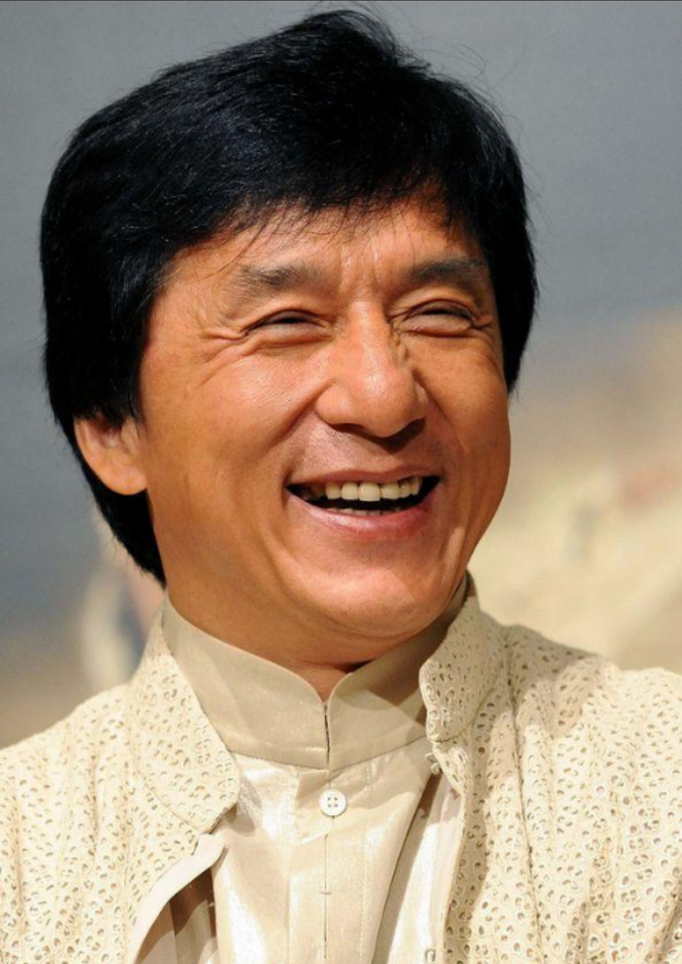




EAST OR WEST
TEAM RYZUKA IS THE BEST
~JACKIE CHAN

Slide 3




STORY

Slide 4


IN THE HEART OF THE VAST OCEAN, WHERE THE HORIZON MEETS THE ENDLESS BLUE EXPANSE, LIES A TALE OF ADVENTURE AND SURVIVAL. MEET TILLU, A CHARISMATIC AND RESOURCEFUL INDIVIDUAL WITH A PENCHANT FOR TROUBLE.
HIS JOURNEY BEGINS INNOCENTLY ENOUGH AS HE BOARDS A LUXURIOUS CRUISE SHIP,
HE EMBARKS ON THIS NAUTICAL ADVENTURE WITH NEITHER A TICKET NOR A COIN TO HIS NAME.IN A DESPERATE ATTEMPT TO SECURE SOME SEMBLANCE OF WEALTH, TILLU'S NIMBLE FINGERS FIND THEIR MARK ON A GLEAMING GOLD WATCH ADORNING THE WRIST OF A WEALTHY PASSENGER. THE HEIST IS SWIFT, BUT FATE HAS A WAY OF CATCHING UP TO THOSE WHO DANCE ON ITS EDGE.A COMMOTION ENSUES AS THE PASSENGER DISCOVERS THE MISSING TREASURE, AND SOON THE SHIP'S CREW DESCENDS UPON TILLU .CORNERED AND WITHOUT AN ALIBI, TILLU IS UNCEREMONIOUSLY CAST ASIDE, SENTENCED TO ISOLATION ON A MYSTERIOUS AND ABANDONED ISLAND. THE ONCE-PROMISING CRUISE BECOMES A DISTANT MEMORY AS TILLU, NOW A CASTAWAY, MUST SUMMON HIS WITS AND SURVIVAL INSTINCTS TO NAVIGATE THE TREACHEROUS CHALLENGES THAT AWAIT HIM ON THE DESERTED SHORES.

Slide 5


Slide 6





MORE STAGES
TO COME

Slide 7




CREATED BY
AYUSH KUMAR
YOJITH KAUSTABH
VAIBHAV TIWADE
HARSHIT PATEL
TUSHAR RANA

